Slide 1
Anomaly Detection using the Multivariate Gaussian Distribution

Slide 2
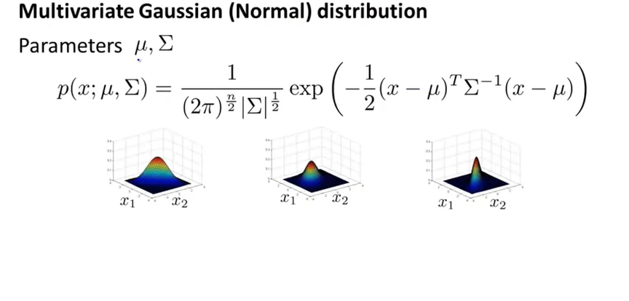
Multivariate Gaussian (Normal) Distribution

Slide 3
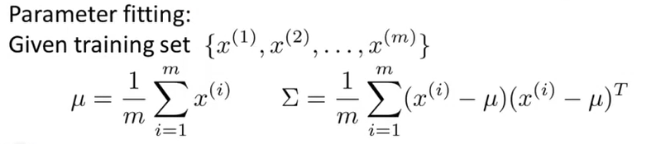

Multivariate Gaussian (Normal) Distribution
$$μ∈R^{n}, Σ ∈ R^{n×n}$$

Slide 4
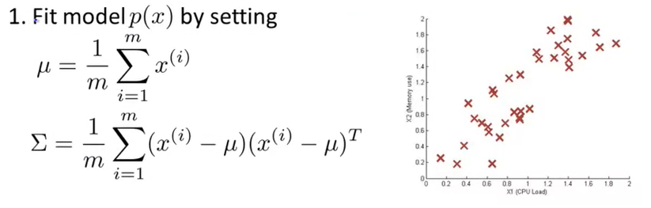
Anomaly detection with the multivariate Gaussian

Slide 5
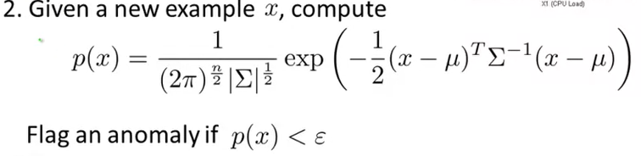

Anomaly detection with the multivariate Gaussian
$$×$$
Anomaly

Slide 6
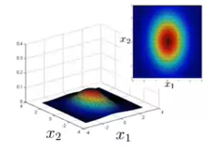

Relationship to original model
Original Model:
$p\left(x\right)=p\left(x_{1};μ_{1};σ_{1}^{2}\right) ×p\left(x_{2};μ_{2};σ_{2}^{2}\right)$ $×…×p\left(x_{n};μ_{n};σ_{n}^{2}\right)$
Contours axes align with x1 and x2 axes

Slide 7
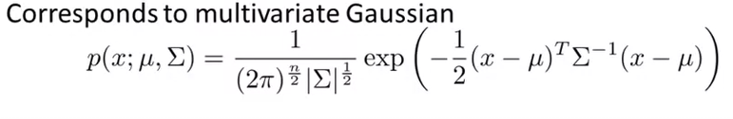
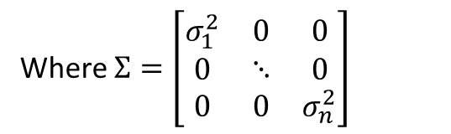
Relationship to original model
Original Model:
$p\left(x\right)=p\left(x_{1};μ_{1};σ_{1}^{2}\right) ×p\left(x_{2};μ_{2};σ_{2}^{2}\right)$ $×…×p\left(x_{n};μ_{n};σ_{n}^{2}\right)$
Contours axes align with x1 and x2 axes
Where $Σ=\left[\begin{matrix}σ_{1}^{2} & 0 & 0 \\ 0 & ⋱ & 0 \\ 0 & 0 & σ_{n}^{2}\end{matrix}\right]$

Slide 8
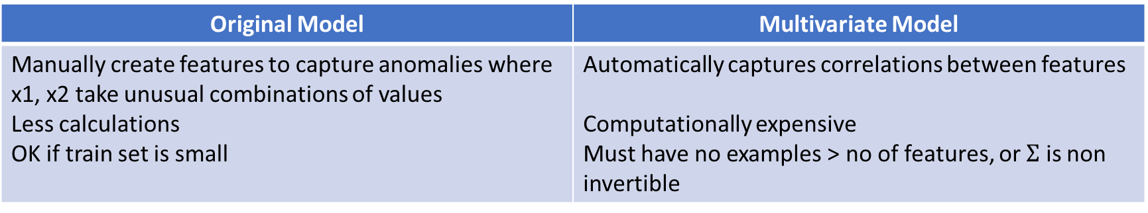
Comparision
Original Model | Multivariate Model
Manually create features to capture anomalies where x1, x2 take unusual combinations of values Less calculations OK if train set is small | Automatically captures correlations between features Computationally expensive Must have no examples > no of features, or $Σ$ is non invertible

